Slide 1

Pregnancy
Prof. Deepthi de Silva
Department of Physiology

Slide 2
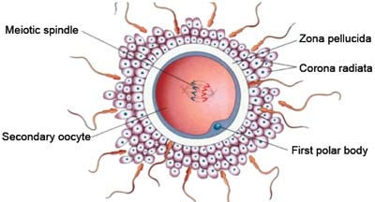
Fertilization

Slide 3
Fertilisation
Attraction of sperm to ovum
Adherence to zona pellucida
Penetration of zona pellucida & Acrosomal reaction of sperm head
Adherence of sperm head to egg cell membrane
Breakdown of cell membrane
Fusion of the sperm head & ovum forms zygote

Slide 4
Acrosomal reaction
Follows sperm binding of zona pellucida
Acrosome breaks down releasing trypsin like enzymes (e.g acrosin)
  Helps sperm penetration through zona
Binds egg cell membrane using fertilin
Reaction in egg membrane (↓ membrane potential + cortical reaction) prevents more sperm entering egg (polyspermy)

Slide 5
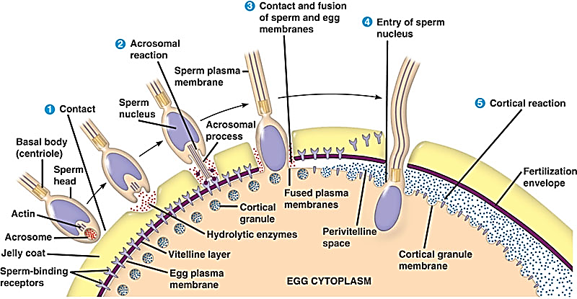
What happens to the sperm?

Slide 6
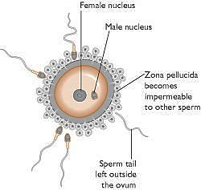
Zygote Formation

Slide 7
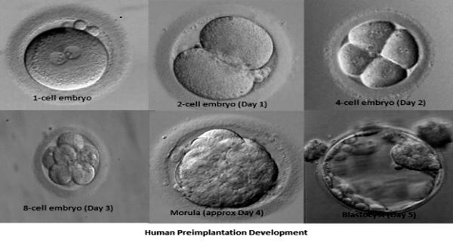
Stages leading to blastocyst formation
1 cell embryo Zygote
2 cell embryo D1
4 cell embryo D2
Morula Day 4
Blastocyst D5

Slide 8
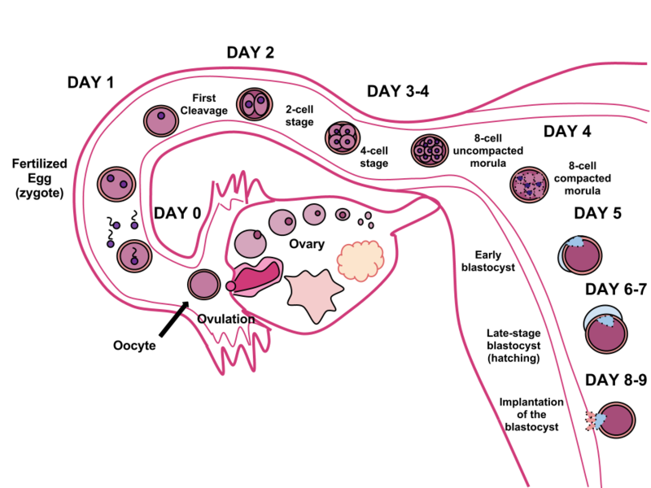

Slide 9
Implantation of Blastocyst
Surrounded by 2 layers
  Outer layer: multicellular Syncytiotrophoblast
  Inner layer: unicellular Cytotrophoblast
Syncitiotrophoblast secretes enzymes- erode endometrium
  Enables implantation (around 7 days)
  Supplies nutrition for developing embryo (up to 8 weeks)

Slide 10
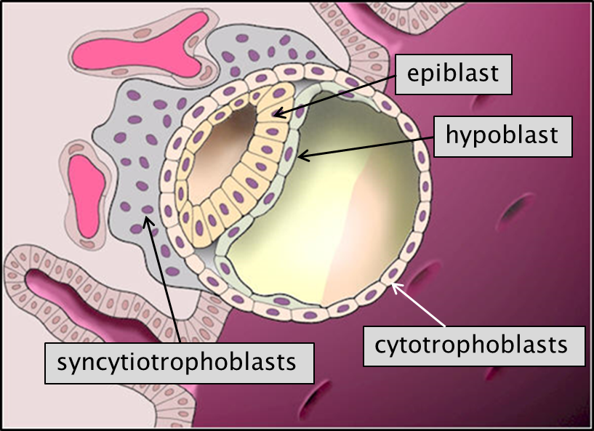

Slide 11
Nutrition of the Fetus
Before implantation - fallopian tube & endometrium (‘uterine milk”)
After implantation to 8 weeks – digestion of endometrium
Beyond 1st week, from placenta too
Trophoblastic
nutrition
Placental conductivity
10 20 30 40
Duration of pregnancy
(weeks)

Slide 12
Placenta Formation
Finger like projections (called villi)
  formed by cytototrophoblast covered with syncytiotrophoblast
Fetal capillaries grow into villi
Sinuses formed by maternal blood develop around villi
No MHC I and II antigens in trophoblast - no rejection by mother’s immune system

Slide 13
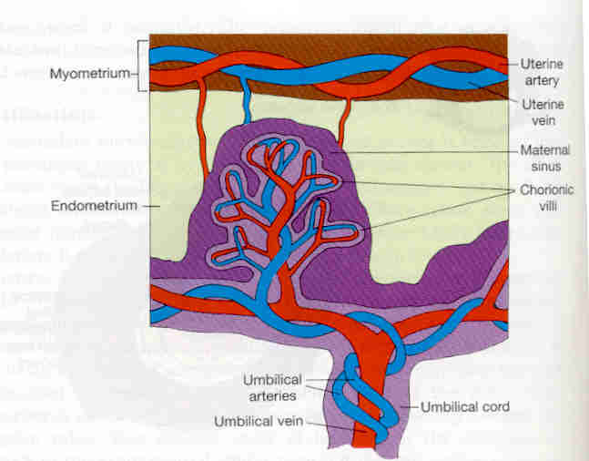
Formation of Placenta
Myometrium
Uterine artery
and vein
Maternal sinus
Chorionic villi
Endometrium
Umbilical
artery and
veins
Umbilical cord

Slide 14
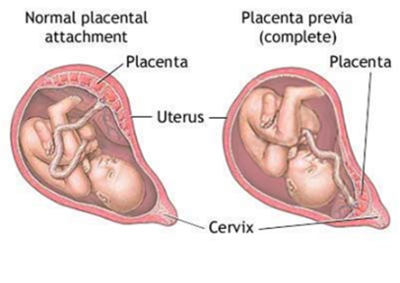
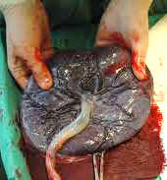

Slide 15
Functions of Placenta
Maintain pregnancy
Transport
  Gases: oxygen and carbon dioxide
  Nutrients
  Waste products
Hormone secretion
Functions increase with maturity

Slide 16
Factors affecting transport in the placenta
Blood flow
Surface area
Properties of the substance
  Concentration gradient
  Molecular weight
  Charge
  Solubility
  Protein binding

Slide 17
Oxygen transfer across placenta
Flow limited
  Increased maternal flow increases fetal oxygenation
Maternal sinus PaO₂ = 50mmHg
PO₂ fetal blood = 30mmHg
Increases with maturity
  increased size and thinning

Slide 18
Fetal adaptations to low PaO₂
Presence of HbF- high affinity to oxygen
Left shift of the fetal Hb-oxygen
dissociation curve
  Increased oxygen carrying capacity
2. High haemoglobin level (fetus)
3. Bohr effect
  Operates in opposite directions in mother and baby

Slide 19
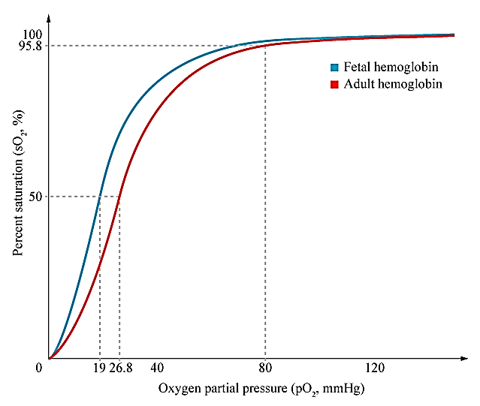

Slide 20
Carbon Dioxide Diffusion
Fetal CO₂ is 2-3mmHg higher than maternal levels
Maternal CO₂ low due to hyperventilation (progesterone effect)
Near normal CO₂ levels maintained in fetus

Slide 21
Bohr Effect
The Hb-O₂ binding affinity inversely related to
  acidity
  concentration of carbon dioxide
Decrease in blood pH or increased CO₂ results in haemoglobin releasing oxygen
Decrease in carbon dioxide or increase in pH, results in loading of oxygen
What is the Haldane effect?

Slide 22
Bohr effect in fetus
Fetal blood entering placenta (through the umbilical artery) has high CO₂
This diffuses into maternal blood
  Maternal blood becomes more acidic
  Affinity of maternal Hb for oxygen decreases
  Releases oxygen
Lowers fetal CO₂ level
  Fetal blood becomes more alkaline
  Affinity of fetal Hb for oxygen increases
  Loads oxygen
Double Bohr effect

Slide 23
Transport of other substances
Glucose –
  facilitated diffusion
  20-30% lower than mother
Fatty acids, ketone bodies
  Diffusion
Water soluble vitamins, AA
  Active transport
Urea, creatinine, uric acid
  diffusion (fetus to mother)
IgG- pinocytosis

Slide 24
Placental hormones : human Chorionic Gonadotrophin (HCG)
Secreted by syncytiotrophoblast (in mat. circulation from 8 days after fertilization)
Peak at 12 weeks (end of 1st trimester) and declines after 20 weeks
β sub unit is basis for pregnancy test: blood at > 8 days; urine >14 days
α unit identical to FSH, LH, TSH

Slide 25
hCG actions
1. Prevents involution of the corpus luteum
CL secretes progesterone, relaxin & oestrogen, which stimulates proliferation of endometrium required for foetal nutrition
(CL involution happens from around 8 but lasts whole pregnancy; not essential after 6 weeks)
2. Stimulates fetal testes to produce testosterone

Slide 26
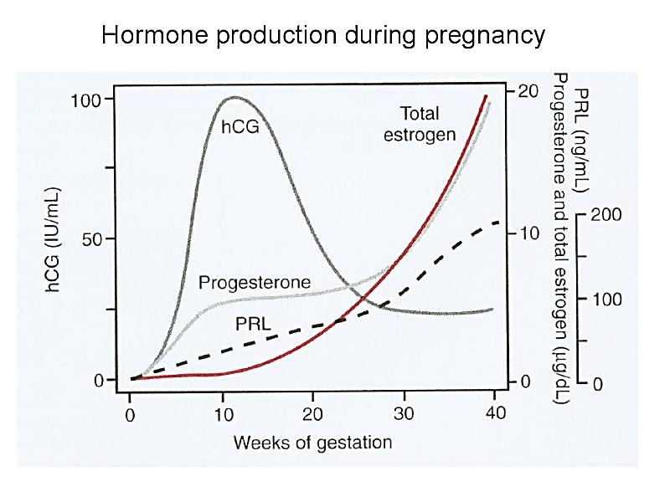
Total oestrogen
hCG
hCS
Progesterone
PRL

Slide 27
Human Chorionic Somatomammotrophin (HCS)
From syncitiotrophoblast
Similar structure to growth hormone & prolactin
Levels rise with placental size
Acts on mother to:
- reduces insulin sensitivity; increases lipolysis → diverts glucose to fetus
- retain nitrogen, calcium, potassium

Slide 28
Feto-Placental unit
Mother
Placenta
Fetal Adrenal
Cholesterol
Pregnenolone
DHEAS
16-OHDHEAS
Cortisol
Aldosterone
Progesterone
Oestradiol
DHEA
Oestriol
Oestriol
16-OHDHEAS

Slide 29
Progesterone
From corpus luteum initially, later placenta
Actions
  Development of conceptus and decidua
  Reduces uterine contractility (with relaxin)
  Reduces prostaglandin secretion (↓ uterine contractions)
  Development of breast
  Reduce bladder, vascular, GI smooth muscle tone
  Increase body temperature

Slide 30
Oestrogen in pregnancy
From corpus luteum initially; later syncitiotrophoblast
Requires normal function of the foetal adrenal gland (feto-placental unit)
Functions to increase maternal breasts, uterus, external genitalia
Relaxes pelvic ligaments
Oestriol in mat urine- measure of fetal health

Slide 31
Other Placental Hormones
POMC
GnRH – stimulates hCG secretion
Inhibin- inhibits hCG
Leptin
Prolactin
Alpha subunit of hCG

Slide 32
Other maternal hormones in Pregnancy
Pituitary: ↑ ACTH, TSH, prolactin;
↓ FSH, LH, (GH)
Adrenal cortex: ↑ cortisol, aldosterone
Thyroid/ parathyroids : ↑ size, secretion

Slide 33

Physiological Changes in Mother
Prof Deepthi de Silva
Department of Physiology

Slide 34
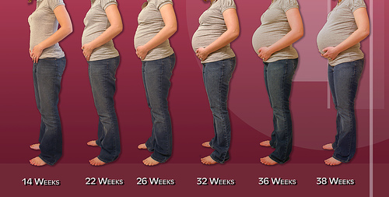
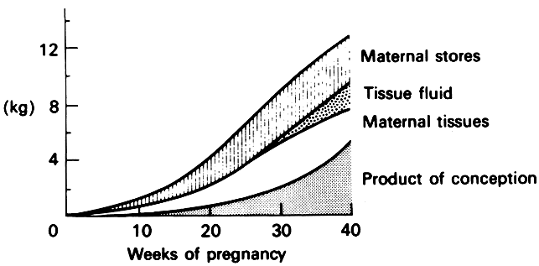
Weight gain
Weight gain ≈ 12.5 kg
  Increases towards 3rd trimester

Slide 35
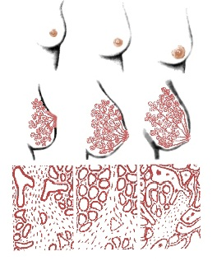
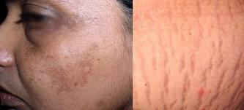
Reproductive system
  ↑size, vascularity, blood flow, secretions
  Cervix softens and is ‘taken up’
  Softening of pelvic ligaments
Breasts
  ↑ size, ↑ vascularity, ↑duct/ alveoli
  Pigmentation of areola
Skin
  Pigmentation
  striae

Slide 36
Uterine contractions
Starts irregularly around 7 weeks
  Progesterone decreases excitability
Painless infrequent contractions in third trimester - Braxton-Hicks contractions
Become painful and more frequent around delivery – Labor contractions

Slide 37
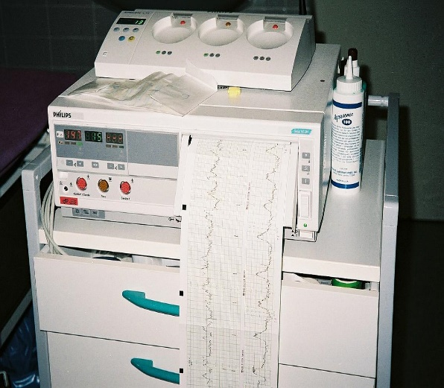
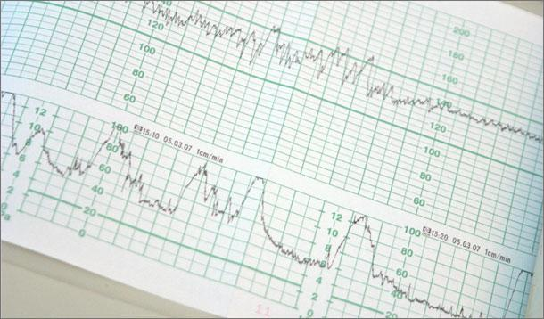
Cardiotograph ‘fetal heart monitor’
Fetal heart rate
Uterine contractions

Slide 38
Plasma proteins
  Hypercoagulability at time of separation of placenta
Total protein levels ↑
Fibrinogen ↑ (↑ ESR)
Factors VII, VIII, IX, and X ↑
  Peripheral circulation vasodilated and pro-thrombotic
Albumin ↓ (oncotic pressure low)
  Increases filtration of fluid to interstitium (& cells)

Slide 39
Blood
↑ Red cell mass 20-30%
  Increased erythropoiesis
  Fe requirement around 4 mg/day
↑ Total WBC count -mainly neutrophils
↓ Platelets
Sodium retention
  Due to ↑ circulating aldosterone and corticosteroids
  Increases ECF

Slide 40
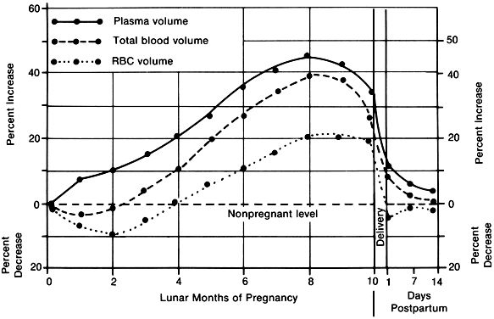
Dilutional Anaemia
↑ Red cell mass 20-30%
Plasma volume increase is more (45-55%) due to fluid retention

Slide 41
Cardiovascular System
CO increases by 30-40% in 2nd trimester
  initially by ↑ HR, later by ↑ SV
HR increases by ≈ 10%
CO plateaus around 24-30 weeks, and is maintained until delivery
comes back to normal later on

Slide 42
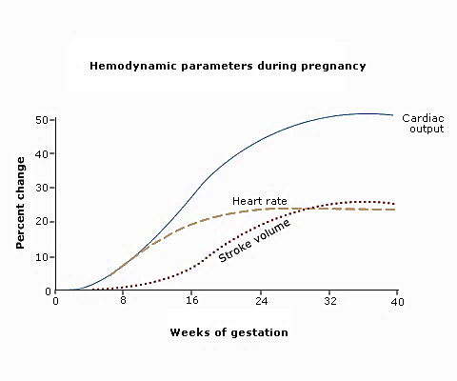
Haemodynamic changes in pregnancy

Slide 43
Blood Pressure
Blood pressure does not change despite higher CO
  Reduced total peripheral resistance with high flow to uterus
  In 2nd trimester slight ↓ in both systolic and diastolic pressure (diastolic more)

Slide 44
Respiratory System
Increased minute ventilation
  Tidal Volume > respiratory rate
↑ PaO₂ and ↓ PaCO₂
More O₂ to and easy transfer of CO₂ from fetus

Slide 45
Gastrointestinal system
↓ Lower oesophageal Sphincter pressure – ↑ reflux
↓ GI secretion and motility – delayed gastric emptying
  Stomach : nausea
  Intestines : constipation
Increased time for absorption of fluid

Slide 46
Glucose Metabolism
Higher circulating levels of glucose (for fetus)
  Due to hCS, placental corticosteroids, insulin antagonists
Storage of fat for later pregnancy and lactation
  Gestational diabetes mellitus

Slide 47
Renal System
Dilation of system
Increased rate of urine formation
  Renal blood flow and GFR increased around 50% of normal from 1st trimester and remain elevated throughout
  ↓ blood urea and serum creatinine levels
Na+ , K+ and water retention
Renal glycosuria
  Renal threshold for glucose is decreased

Slide 48
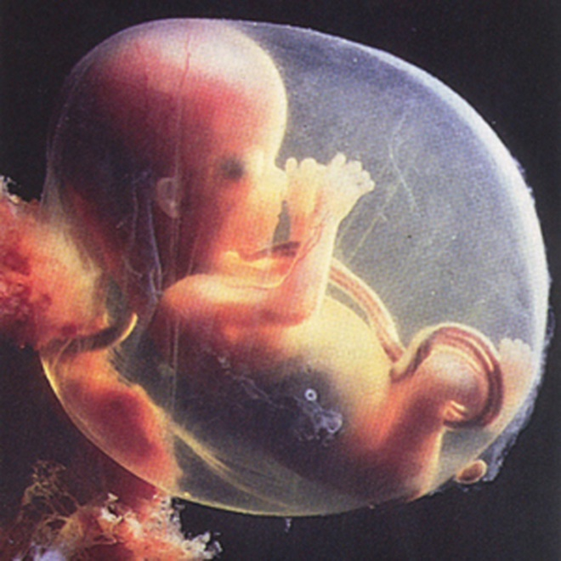

Slide 49
Iron metabolism
Erythropoiesis ↑ from early pregnancy
Increased Fe turnover and unsaturated transferrin
Requirement is around 4 mg/day
Supplemented

Slide 50
Nutrition
↑ need for nutrients
  Additional calories
  Supplementations given; otherwise deficiencies occur
  Protein, iron, calcium, folate

Slide 51
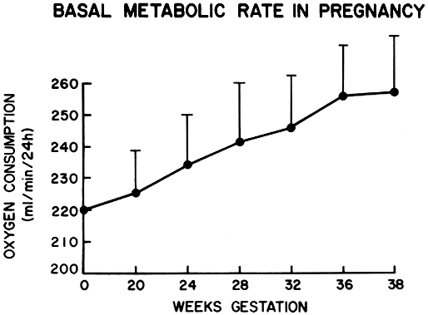
Basal Metabolic Rate
due to increased circulating thyroxine and adrenocortical hormones
Side effect – increased thermogenesis

Slide 52
Lipid metabolism
High circulating levels of TG and free fatty acids

Slide 53
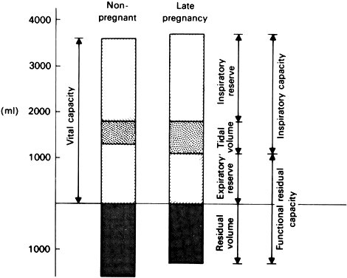
Altered lung volumes
Altered thoracic anatomy
Increased load in abdomen
  Diaphragmatic action is less
  ↓ ERV , RV, FRC and VC
  ↑ TV and IRV
  No change in FEV₁ and PEF

Slide 54
Fetus is an allograft
Requires maternal tolerance not to be rejected
  MHC Ag complex is absent in trophoblast
  Relatively non immunogenic interface in fetus
  Filtering out of harmful antibodies by placenta
↑B Cells, IgG

Slide 55
Other effects
Morning Sickness
  Elevated hCG, oestrogen / progesterone
  Hyperemesis Gravidarum – dehydration, nutritional deficiencies, electrolyte imbalance
Sensitive / Sore Breasts - Breast Growth/ hhormones
Frequent Urination
Constipation (hormones and pressure on the rectum)
Fluctuating Emotions
Pains due to stretching uterus
Vaginal discharge (increased secretions)
Breathlessness (hyperventilation)
Ankle oedema , varicosities, haemorrhoids (↑ venous pressure)
‘Lightening’

